Slide 1

Wednesday, November 3rd, 2021
Unit 3. My Friends
Lesson 7. Looking Back+ project

Slide 2

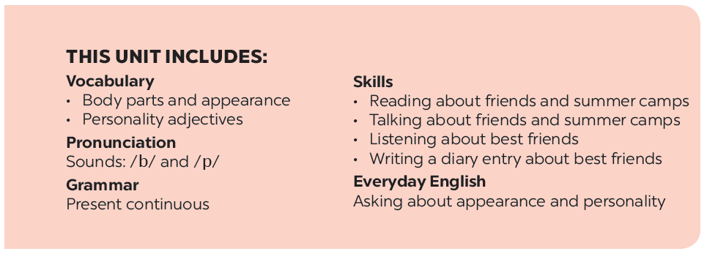

Slide 3







Vocabulary
Grammar
Choose the correct answer A, B, or C.
Put the verbs in brackets in the present continuous.
Answer questions about your classmates.
Put the verbs in brackets in the present simple or present continuous.

Slide 4

Vocabulary

Slide 5


Choose the correct answer A, B, or C.
1.
Nick is very . He makes everyone laugh!
A.
confident
B.
funny
C.
active
2.
My sister always does her homework before class.
She’s very .
A.
hard-working
B.
creative
C.
careful
3.
Mi is . She helps me with my homework.
B.
C.
kind
A.
hard-working
friendly
4.
He is a person. He cares about everybody.
A.
B.
friendly
C.
clever
caring
5.
My best friend is very . She likes doing activities.
A.
B.
clever
C.
active
creative

Slide 6
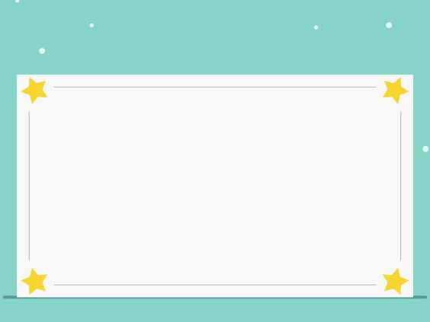

Answer questions about your classmates.
1.
Who has long hair in your class?
2.
Who has a small nose?
3.
Who has a round face?
4.
Does the classmate next to you have long hair?
5.
Does the classmate next to you have big eyes?

Slide 7

Grammar

Slide 8


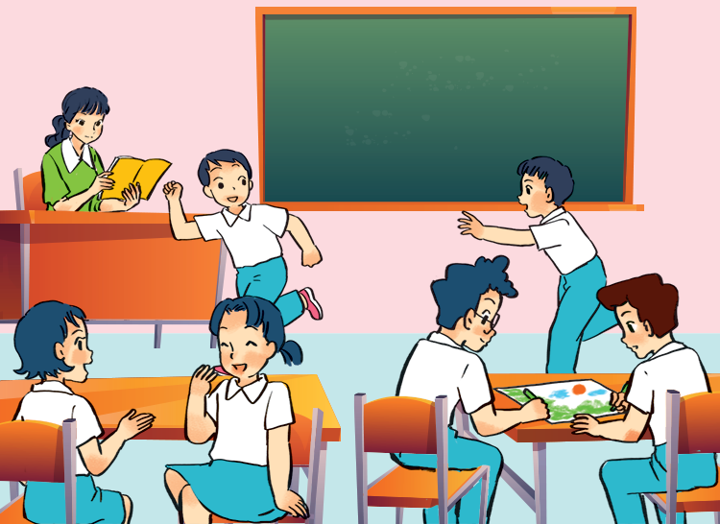
Put the verbs in brackets in the present continuous.
This is my class during break time. Some boys
(1. run) _______ around the class. Mi and Mai
(2. talk) _______. Nam and Phong (3. not talk) _______. They (4. draw) _______ something.
My teacher is in the classroom too. She (5. not teach) _______. She’s reading a book.

Slide 9
Put the verbs in brackets in the present continuous.
This is my class during break time. Some boys
(1. run) are running around the class. Mi and Mai
(2. talk) are talking. Nam and Phong (3. not talk) are not talking / aren’t talking . They (4. draw) are drawing something. My teacher is in the classroom too. She (5. not teach) is not
teaching / isn’t teaching. She’s
reading a book.

Slide 10

Put the verbs in brackets in the present simple or present continuous.
are
doing
you (do) ?
1.
A: What
you (do) ?
B: I (write)
an email to my friend.
am writing / ‘m writing
an email to my friend.
2.
cycles
A: Mai usually (cycle) to school.
B: Really? I (not cycle)
I (walk) everyday.
don’t cycle.
.
walk
3.
A: Where is Phong?
he (do) his homework?
he (do) his homework?
Is
doing
is reading/ ‘s reading
B: No, he (read)
a book in the living room.
a book in the living room.

Slide 11


My class
yearbook
How to make
a class yearbook
Friends
1.
Stick a photo / drawing of the friend sitting next to you on a large sheet of paper.
Name: ....................
2.
Interview your friend to find out about him / her (e.g. favourite subjects, favourite books, what he / she likes, etc.).

Slide 12
My class
yearbook
How to make
a class yearbook
Friends
3.
Write a short description of your friend. describe his / her appearance and personality. add some information you have from the interview.
Name: ....................
4.
Decorate the page. Show it to your class and talk about it.

Slide 13
My class
yearbook
How to make
a class yearbook
Friends
5.
Together make a class yearbook.
Name: ....................

Slide 14
Now I can … |  |  | 
use the words for body parts, appearance and personality.
pronounce the sounds /b/ and /p/ correctly.
use the present continuous to talk about things happening now.
ask about appearance and personality.
read about friends and summer camps.
talk about friends and summer camps.
listen about best friends.
write a diary entry about my best friend.
✓
✓
✓
✓
✓
✓
✓
✓
✓
✓
✓
✓
✓
✓
✓
✓
✓
✓
✓
✓
✓
✓
✓
✓

Slide 15







